Slide 1


Speech Emotion Recognition in Audio using ML Techniques

Slide 2
GROUP MEMBERS & ROLES
Jayapal Reddy Myaka , 700741818
Asha Pasupulate , 700725847
Pramod Reddy Parshepu , 700727037
Pranathi Reddy Mamidi , 700742261
a. Pramod - Dataset & visualizations
b. Asha - Detailed design of features and analysis.
c. Jayapal - Implementation & preliminary results.
d. Pranathi - Project management, documentation, and report.

Slide 3




Introduction
One of the most natural ways we as humans may communicate is through speaking.
We rely on it so much that we understand its significance while using other modes of communication such as emails and text messages, where we frequently employ emojis to represent the emotions associated with the messages.
Because emotions play such an important role in communication, detecting and analyzing them is critical in today's digital age of remote communication.
Because emotions are subjective, detecting them is a difficult task.
The problem of speech emotion recognition can be solved by analyzing one or more of these features.
Following the lexical characteristics would need a transcript of the speech, which would necessitate an additional step of text extraction from speech if one wanted to predict emotions from real-time audio.

Slide 4
Data Source
For this project, we will be using the RAVDESS dataset which is the abbreviated form of the Ryerson Audio-Visual Database of Emotional Speech and Song dataset.
Ryerson Audio-Visual Database of Emotional Speech and Song (RAVDESS) which is a Speech audio-only file (16bit, 48kHz .wav) from the RAVDESS.
The complete dataset of speech and song, audio, and video (24.8 GB) is available from Zenodo.
Construction and perceptual validation of the RAVDESS are described in our Open Access paper in PLoS ONE.
This portion of the RAVDESS contains 1440 files: 60 trials per actor x 24 actors = 1440.
The RAVDESS contains 24 professional actors (12 female, 12 male), vocalizing two lexically-matched statements in a neutral North American accent.
Speech emotions include calm, happy, sad, angry, fearful, surprise, and disgust.
Each expression is produced at two levels of emotional intensity (normal, and strong), with an additional neutral expression.

Slide 5

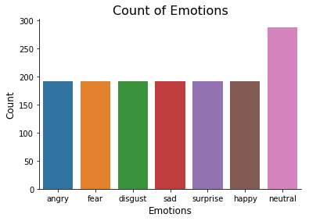
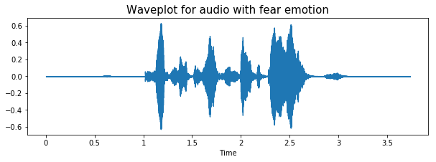
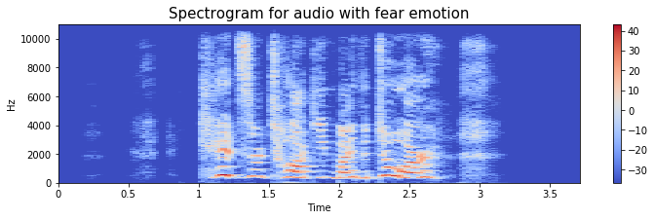
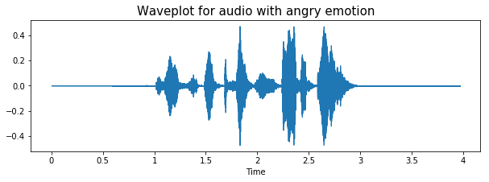
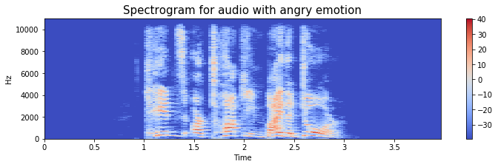
Data Visualization and Exploration

Slide 6
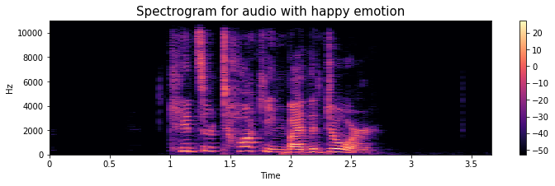
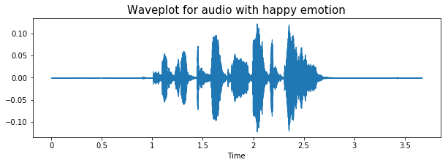
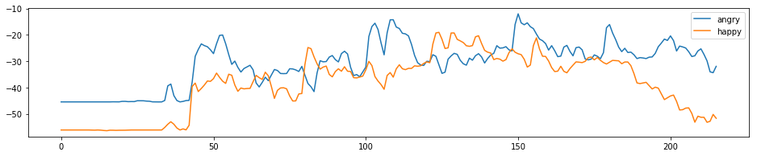
Data Visualization and Exploration
We can also plot waveplots and spectrograms for audio signals.
Waveplots let us know the loudness of the audio at a given time.
A spectrogram is a visual representation of the spectrum of frequencies of sound or other signals as they vary with time.
It’s a representation of frequencies changing with respect to time for given audio/music signals.

Slide 7

Data Augmentation
In data augmentation, small perturbations are added to the initial training set to create synthetic data samples.
Noise injection, shifting time, pitch, and speed changes can all be applied to audio to generate syntactic data.
This will enhance the model's ability to generalize and make it invariant to those perturbations.
This requires conserving the original label on the perturbations in order to work.
The image can be rotated, zoomed, and shifted to augment the data.

Slide 8
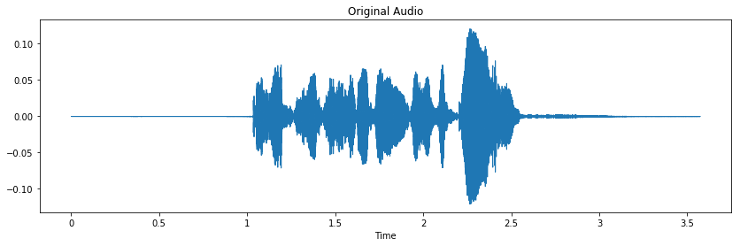
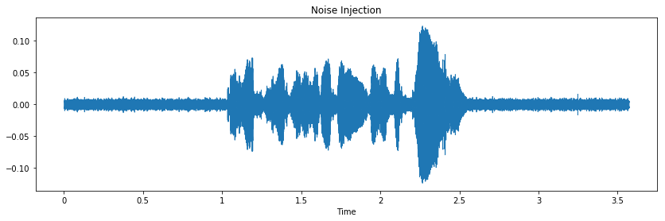
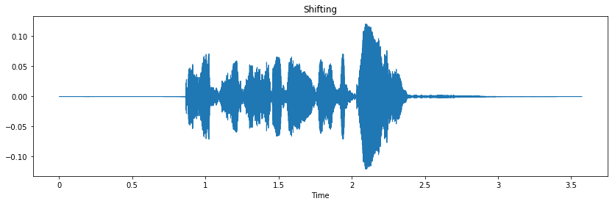
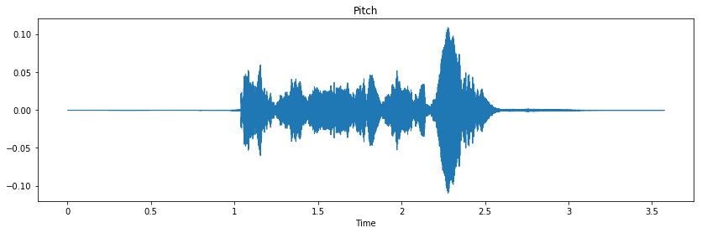
Data Visualization and Exploration

Slide 9
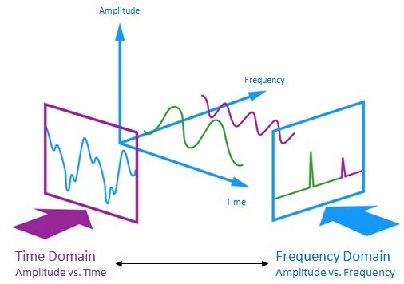
Feature Extraction
Extraction of features is a very important part of analyzing and finding relations between different things.
The data provided by audio cannot be understood by the models directly so we need to convert them into an understandable format for which feature extraction is used.
The audio signal is a three-dimensional signal in which three axes represent time, amplitude, and frequency.

Slide 10
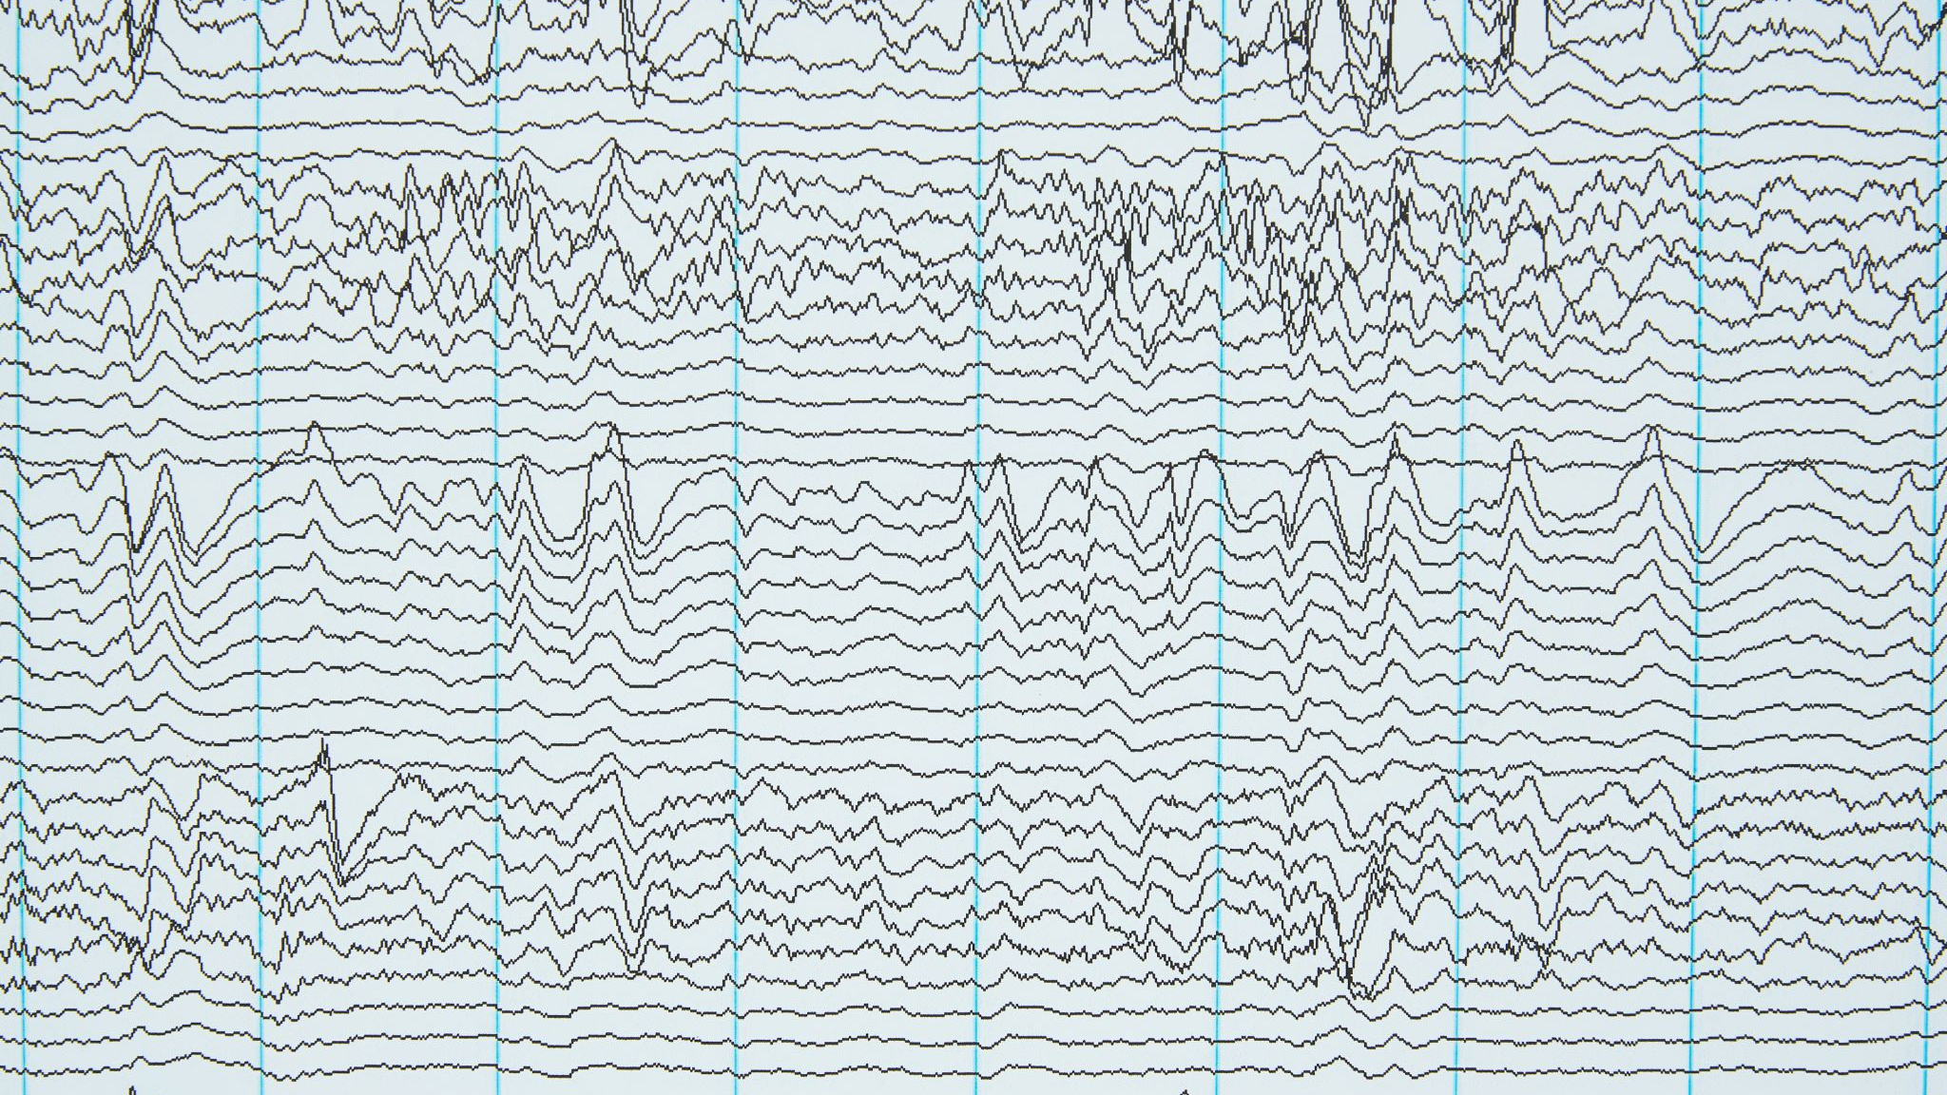
Feature Extraction
Zero Crossing Rate: The rate of sign changes of the signal during the duration of a particular frame.
Energy: The sum of squares of the signal values, normalized by the respective frame length.
The entropy of Energy: The entropy of sub-frames normalized energies. It can be interpreted as a measure of abrupt changes.
Spectral Centroid: The center of gravity of the spectrum.
Spectral Spread: The second central moment of the spectrum.
Spectral Entropy: Entropy of the normalized spectral energies for a set of sub-frames.
Spectral Flux: The squared difference between the normalized magnitudes of the spectra of the two successive frames.
Spectral Rolloff: The frequency below which 90% of the magnitude distribution of the spectrum is concentrated.
MFCCs Mel Frequency Cepstral Coefficients form a cepstral representation where the frequency bands are not linear but distributed according to the mel-scale.
Chroma Vector: A 12-element representation of the spectral energy where the bins represent the 12 equal-tempered pitch classes of western-type music (semitone spacing).
Chroma Deviation: The standard deviation of the 12 chroma coefficients.

Slide 11
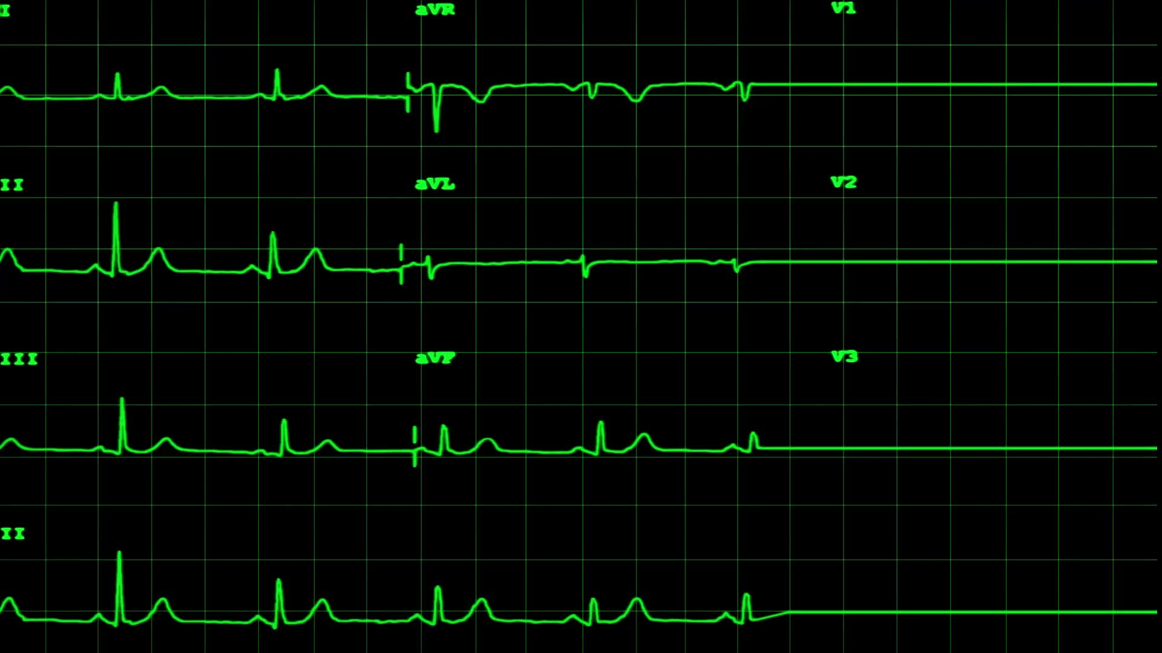
Features Used
Mel Frequency Cepstral Coefficients, Mel Spectrogram, and Chroma are all examples of MFCC. They were extracted using Librosa.
MFCC: By far the most explored and used characteristic in this dataset was MFCC. It represents a sound's short-term power spectrum.
Mel Spectrogram: This is just a spectrogram that represents amplitude on a Mel scale.
Chroma: In a normal chromatic scale, a Chroma vector is a 12-element feature vector that indicates how much energy of each pitch class is present in the signal.

Slide 12
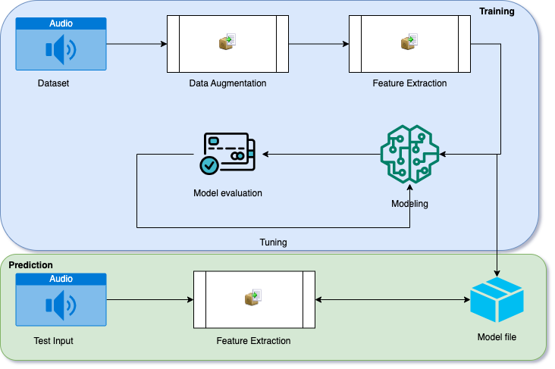
System flow

Slide 13
Modeling
Logistic Regression
This statistical model (also known as a logit model) is often used for categorization and predictive analytics.
Logistic regression calculates the likelihood of an event happening.
Logit(pi) is the dependent or response variable in this logistic regression equation, while x is the independent variable.
In this model, the beta parameter, or coefficient, is frequently determined via maximum likelihood estimation (MLE).
This approach iteratively examines alternative beta values in order to get the best fit of log odds.
The log-likelihood function is produced by all of these rounds, and logistic regression aims to maximize this function to get the optimal parameter estimate.
Once the best coefficient (or coefficients, if more than one independent variable is present) is determined, the conditional probabilities for each observation may be computed, recorded, and totaled to provide a forecast probability.

Slide 14
Modeling
SVM
Many people favor support vector machines because they generate substantial accuracy while using minimal computing power.
SVM, or Support Vector Machine, may be used for both regression and classification applications.
However, it is often employed in classification aims.
The support vector machine method seeks a hyperplane in N-dimensional space (N — the number of features) that distinguishes between data points.
There are several hyperplanes that might be used to split the two groups of data points.
Our goal is to discover a plane with the greatest margin, or the greatest distance between data points from both classes.
Maximizing the margin distance gives some reinforcement, allowing subsequent data points to be categorized with more certainty.
Hyperplanes are decision boundaries that aid in the classification of data items.
Data points on each side of the hyperplane might belong to distinct classes. Furthermore, the size of the hyperplane is determined by the number of features.

Slide 15
Modeling
Adaboost Classifier
Boosting is a kind of machine learning ensemble technique in which models are added in sequential order and subsequent models in the sequence correct the predictions generated by earlier models in the sequence.
AdaBoost, which stands for "Adaptive Boosting," is a boosting ensemble machine learning algorithm that was one of the first to be effective.
Although alternative algorithms may be utilized, AdaBoost combines predictions from small one-level decision trees known as decision stumps.
As the AdaBoost method aims to employ numerous weak models and modify their forecasts by adding further weak models, decision stump techniques are used.
Starting with one decision tree, the training algorithm finds misclassified cases in the training dataset and gives those examples additional weight.
Another tree is trained on the same data, but this time the misclassification mistakes are weighted.
This procedure is continued until the required number of trees has been added.

Slide 16
Modeling
XG Boosting
XGBoost is a technique of ensemble learning. It is not always adequate to depend on the outcomes of a single machine learning model.
Ensemble learning provides a methodical approach to combining the predictive capacity of numerous learners.
The end result is a single model that aggregates the output of numerous models.
Boosting trees are constructed consecutively, with each succeeding tree attempting to minimize the mistakes of the prior tree.
Each tree learns from the trees that came before it and update the residual mistakes.
As a result, the following tree in the sequence will learn from an updated version of the residuals.

Slide 17
Validation Method
True Positive (TP): The projected value is the same as the actual value in this case. The actual value was positive, and the model predicted that the value would be positive.
True Negative (TN): True Negative (TN) indicates that the projected value is the same as the actual value. The actual value was negative, and the model predicted that the value would be negative as well.
False Positive (FP): The False Positive (FP) error is a Type 1 error. The expected value turned out to be incorrectly predicted. Although the actual number was negative, the model projected that it would be positive.
False Negative (FN): A Type 2 error is a False Negative (FN). The expected value turned out to be incorrectly predicted. Although the actual number was positive, the model predicted that it would be negative.

Slide 18
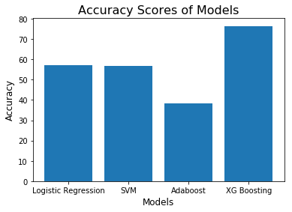
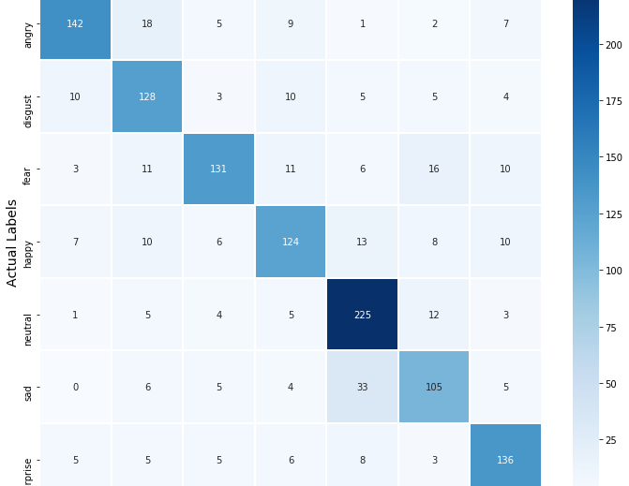
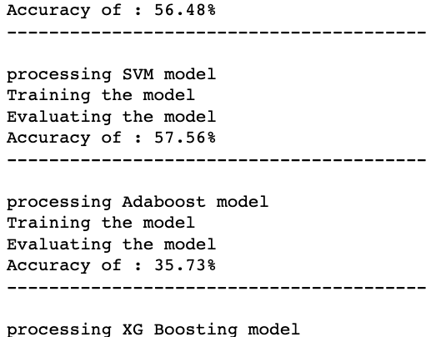
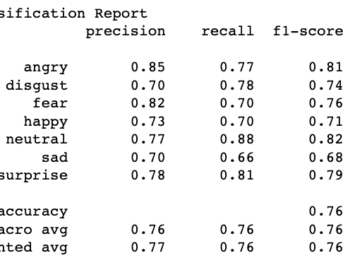
Results

Slide 19
Conclusion
We can see the models are not as accurate in predicting surprise, and angry emotions and it makes sense also because audio files of these emotions differ from other audio files in a lot of ways like pitch, speed, etc whereas We overall achieved 76% accuracy on our test data using Xg Boosting algorithm and it’s decent but we can improve it more by applying more augmentation techniques and using other feature extraction methods.

